Slide 1

Subject
Artificial Intelligence (Lab)
---------------------------------------------------------------------
Presentation for Project
“AI - Searches”
---------------------------------------------------------------------
Presented by
Abdul Basit Khan
Mubashhir Qamar
---------------
---------------

Slide 2
Overview
This presentation will have a brief discussion on the following aspects:
Introduction
Objective
Problem Statement
Requirement Gathering
Design
Conclusion

Slide 3
Introduction
In Artificial Intelligence, Search techniques are universal problem-solving methods
Problem-solving agents in AI mostly used these search strategies or algorithms to solve a specific problem
Searching problems can be solved using trees and graphs
For graphs, they are considered to be more accurate in searches but they can either be directed or undirected.
Directed means that they contain a specific direction for the search flow whereas undirected does not have any direction which means the graph can go either way
Searches are of two types; the uninformed search (blind search) and the informed search

Slide 4
Objective
The objective of this project is to make a problem-solving agent that can perform various searches using some AI techniques
This project is useful to study different AI algorithms and to have a good hand on them
It enables us to choose nodes (initial node or the goal node) by ourselves in order to recognize how searches are being performed based on different techniques
The goal is to have an understanding on the problems which involves several heuristics as they are the complex ones,

Slide 5
Problem Statement
Searching problems are becoming more complex
No such problem-solving agent to deal with problems involving heuristics
Fewer AI models with uninformed search techniques as they consume some time to get to the solution

Slide 6
Requirement Gathering
Searching through graphs
Graphs can either be directed or undirected
Selection and drawing tools for nodes and edges
Several techniques must be implemented via informed and uninformed search methods
Set nodes, edges, weights and heuristics
Delete nodes, edges, weight and heuristics
Can go with any branching factor starting with the initial value of 1

Slide 7
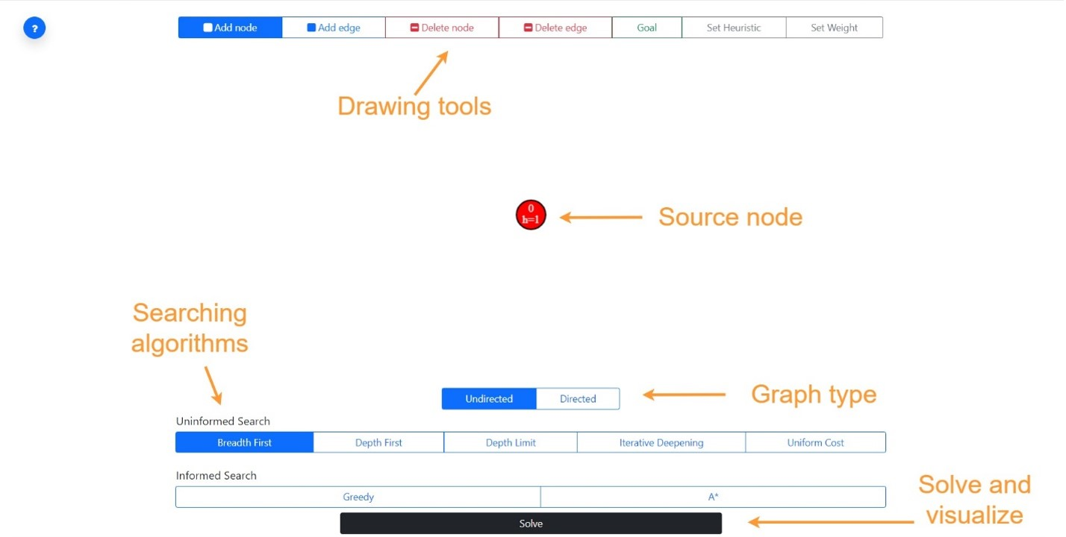
Design

Slide 8
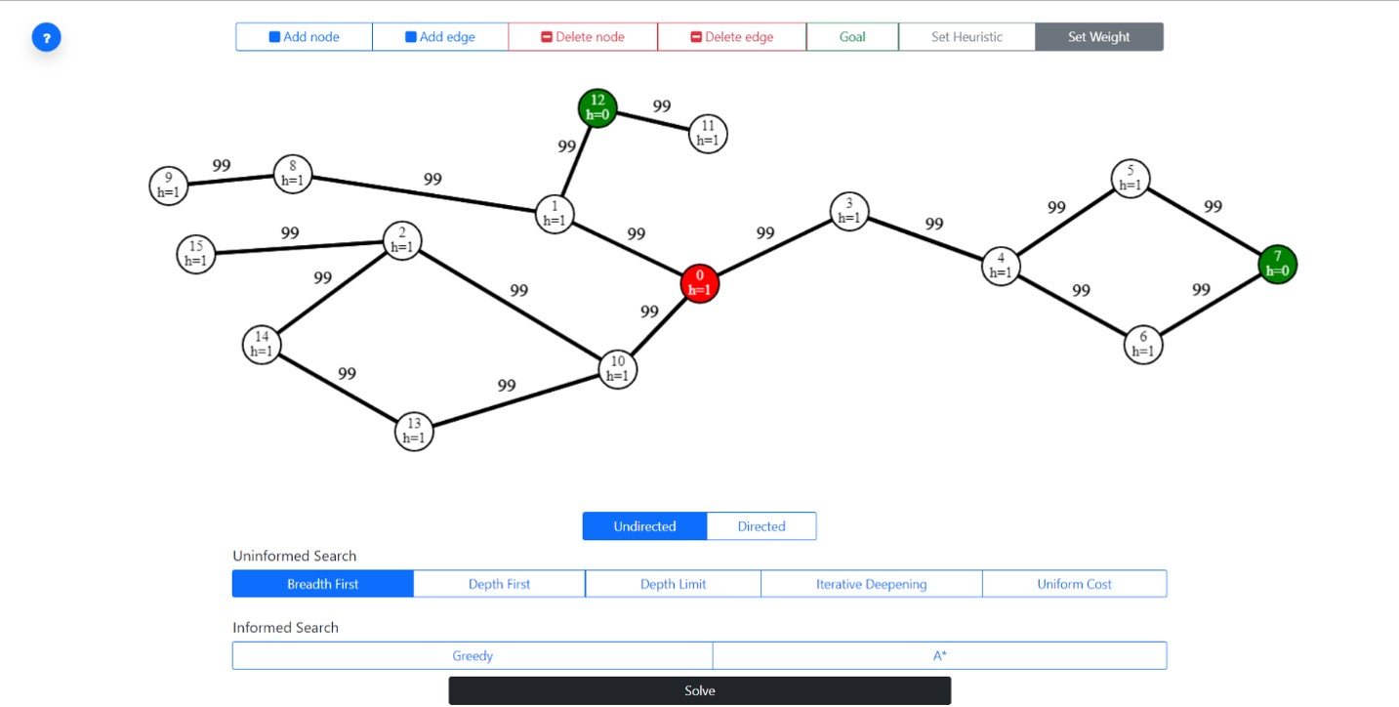
Design

Slide 9
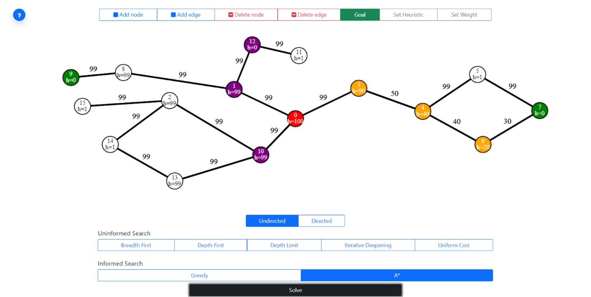
Design

Slide 10
Conclusion
Basic and complex searching problems are now easy
Problem solving agent must be the rational
Uninformed searches take a bit more time as compared to informed searches
Uninformed searches have information of the goal node
Directed graphs can go either way where as undirected graphs have only one direction
A* search method is the efficient one among all if branching factor is to be taken into consideration

Slide 11
THANK YOU
---------------------------------------------------------------------
ANY QUERIES???

